Slide 1

Runway and Air Traffic Management Optimization
An innovative approach to minimize runway congestion, reduce delays, and enhance safety through optimized runway scheduling.
Presented By – Karan Majotra

Slide 2
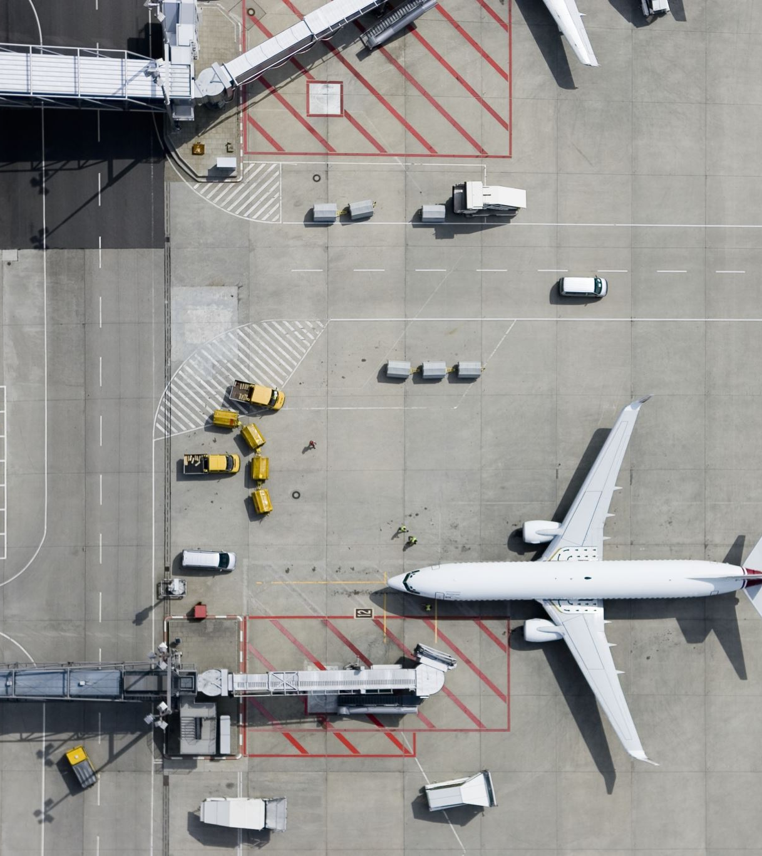
CHALLENGE :
Airports face congestion due to limited runway availability, especially during peak hours or adverse weather.
IMPACTS :
Delays in takeoff/landing schedules.
Increased fuel consumption.
Safety risks due to close proximity of aircraft.

Slide 3
Fuel Wasted During Idling:
Aircraft idling on the ground and in holding patterns results in significant fuel usage.
On average, each idling jet consumes about 0.8 gallons per minute during taxiing and holding patterns. This is especially impactful during peak congestion times at major airports​

Slide 4
Fuel Consumption and Delay Costs in U.S. Aviation
Annual Jet Fuel Use:
602 million barrels (or 25 billion gallons).
Idling Waste: 1.5 to 2.5 billion gallons lost in delays (6-10% of total).
Financial Impact:
Fuel Cost: $6.21 per gallon Wasted .
Fuel Cost: $9.3 to $15.5 billion per year.
Sources: EIA, EESI, Airlines for America, Bureau of Transportation Statistics

Slide 5
Continued:
Delay Costs:
Each minute of delay = $100
Annual cost from delays: $33 billion (lost productivity, operational costs)
Sources: EIA, EESI, Airlines for America, Bureau of Transportation Statistics

Slide 6
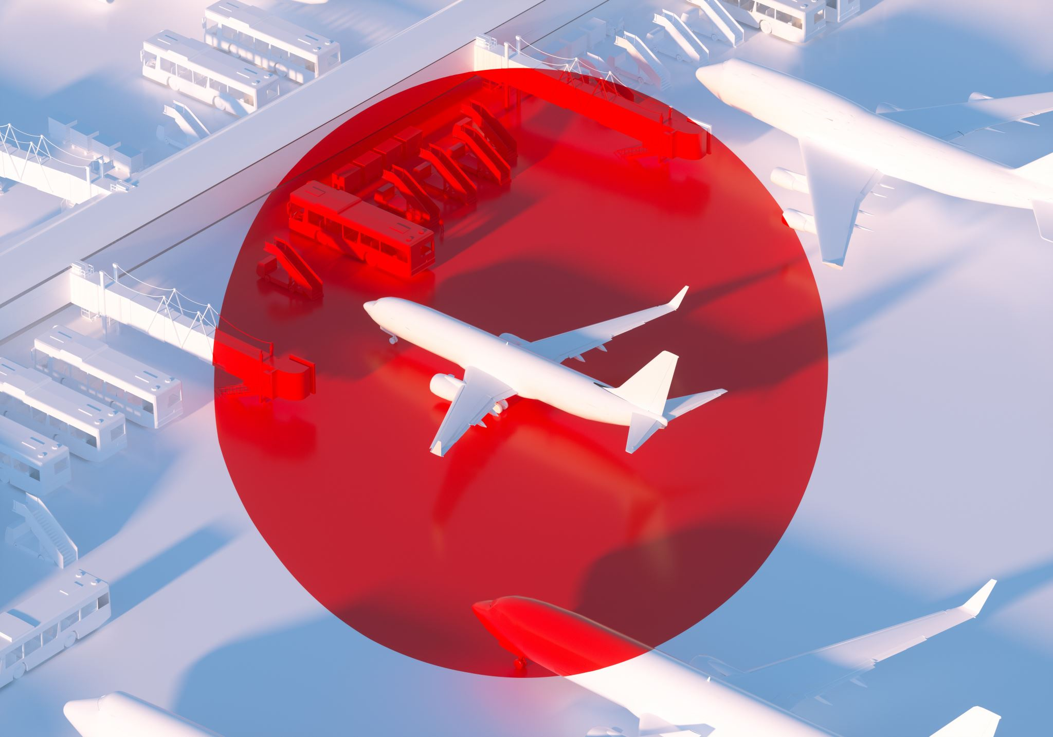
WHO ARE MY STAKEHOLDERS?
Primary Stakeholders: Airlines, airport management, pilots, air traffic controllers, and passengers.
EXPERIENCES AND IMPACTS:
Airlines: Increased operational costs and fuel consumption.
Passengers: Long delays and travel disruptions.
Controllers: Increased workload and potential safety concerns.

Slide 7
WHAT IS THE SOLUTION TO THIS ?
The aim is to develop an intelligent scheduling algorithm that optimizes the use of runways for both takeoffs and landings in real-time.
The algorithm continuously analyzes changing factors, like weather conditions, fuel levels, and schedule delays, to prioritize flights based on urgency.
By dynamically managing these runway slots, the solution adjusts to traffic volume and environmental conditions, helping reduce congestion, fuel consumption, and delays.
This real-time adaptability ensures that flights are scheduled in a way that maximizes runway availability, allowing for more efficient takeoff and landing sequences.

Slide 8
SOLUTION BREAKDOWN:
Dynamic Slot Allocation:
Method: Prioritize flights by urgency using a priority queue (e.g., based on fuel, schedule).
Real-Time Data Collection: The system gathers live data on flight schedules, fuel levels, and emergency statuses using APIs like OpenSky Network for aircraft positions and FAA SWIM for U.S. air traffic updates. This allows for real-time prioritization. Benefit: Ensures timely and safe landings/takeoffs based on current conditions.

Slide 9
Graph-Based Airspace Management:
Method: Model airspace as a graph with nodes and paths.
Tool: Use shortest-path algorithms to reduce congestion.
Optimal Routing with Shortest Path Algorithms: Using algorithms like Dijkstra’s or A*, the system calculates the quickest route to the runway, minimizing congestion both on the ground and in the air.

Slide 10
Runway Usage Scheduling:
Method: Round-Robin or Shortest Job Next (SJN) scheduling to optimize runway time. allocation
Benefit: Balances landing and takeoff sequences for minimal idle time.
Predictive Models: Historical data analysis allows the system to predict average times needed for landings and takeoffs under different conditions, further optimizing slot assignments.

Slide 11
Collision Avoidance:
Method: Conflict Detection: AVL trees or interval scheduling algorithms track and check time slots to avoid overlap, ensuring that no two planes are scheduled in the same runway or airspace segment simultaneously.
Benefit: Ensures no two planes occupy the same runway or airspace segment at the same time

Slide 12
Real-Time Monitoring and Adjustments with Heap Structures:
Heap-Based Priority Adjustments: A min-heap or max-heap structure monitors flights next in line for takeoff or landing.
Benefit:This allows the system to quickly reprioritize flights based on delays, emergencies, or updated data, ensuring continuous optimization.

Slide 13

Technical Uniqueness:
Real-Time Monitoring and Adjustments:
Method: Use heap structures (min-heap or max-heap) to track and adjust the queue as conditions change.
Uniqueness: Dynamic adaptation based on real-time events for optimized efficiency.

Slide 14
Business Model:
Users:
Airlines and airports as customers.
Value Proposition:
Cost reduction in fuel and operational efficiency.
Improved passenger satisfaction and safety.

Slide 15

Benefits and Impact
Reduced Delays: Efficient scheduling cuts down on wait times.
Fuel Savings: Less time in holding patterns lowers fuel consumption and emissions.
Enhanced Safety: Reduced close encounters and improved airspace management.

Slide 16
THANK YOU!
Thank you for your time and attention
Feel free to reach out for any questions or further discussion.
Karan Majotra

